Slide 1
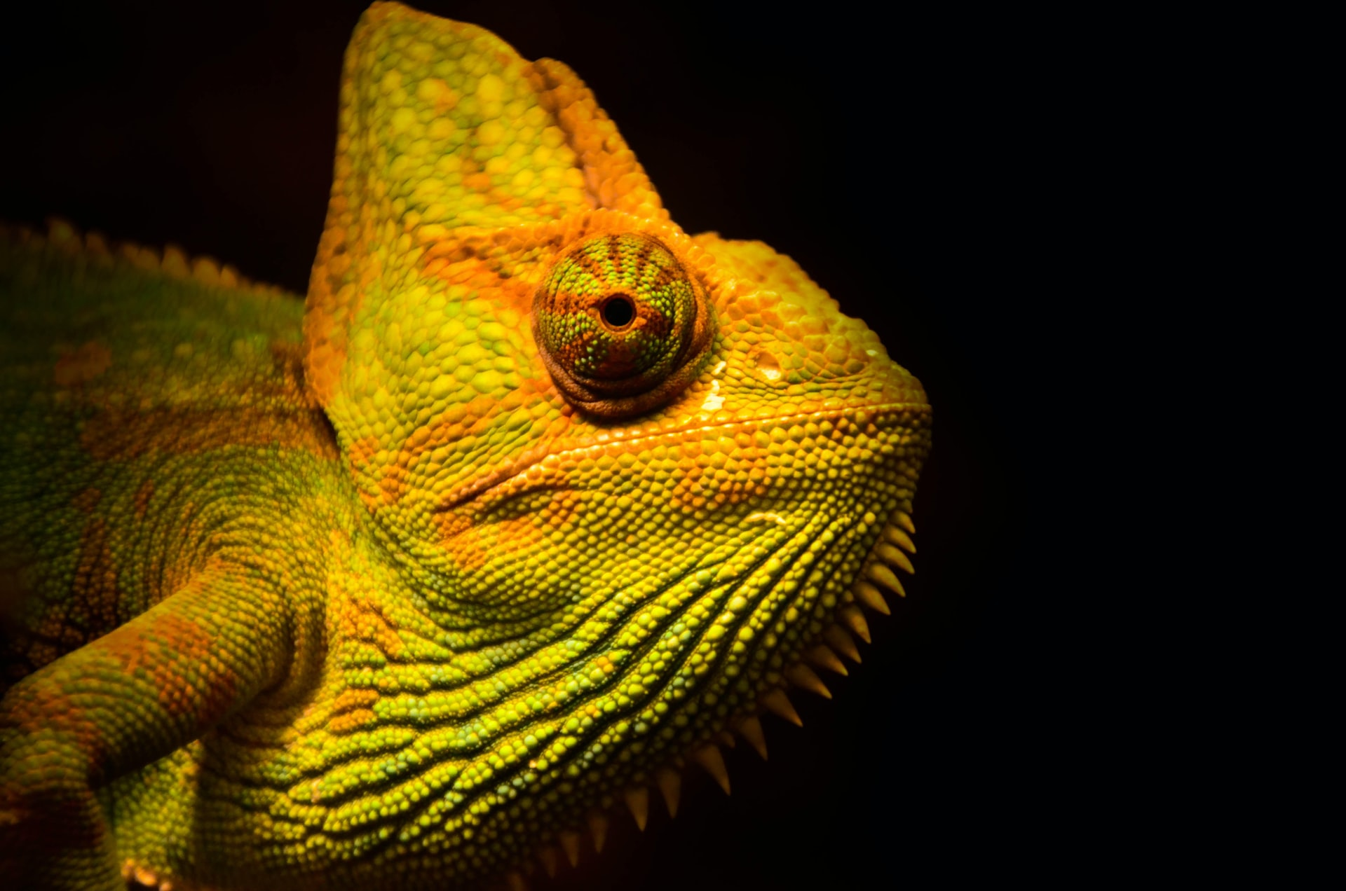
The Future of Tropical Rain Forests IDS 2935
Origins of Tropical Biodiversity

Slide 2
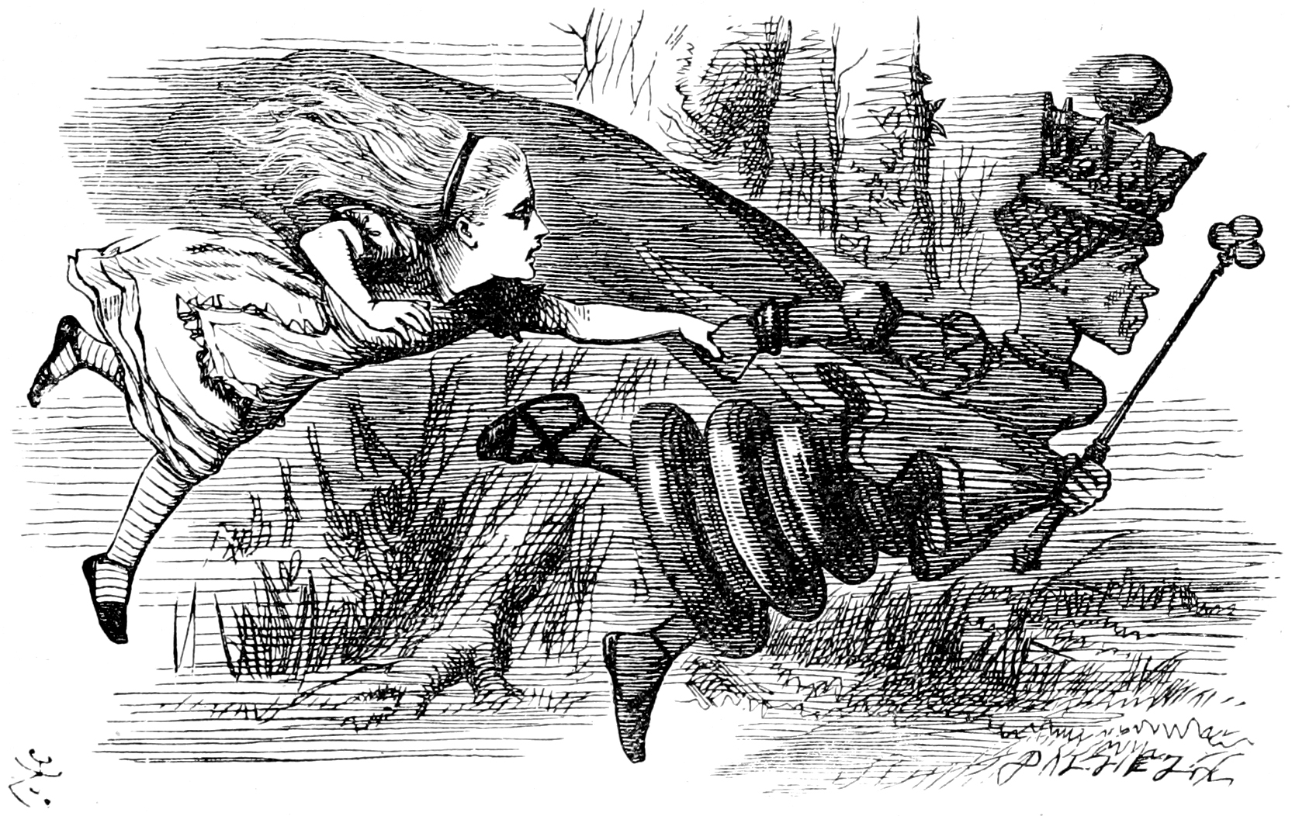
”It takes all the running you can do, to keep in the same place.”
The Red Queen
Alice's Adventures in Wonderland

Slide 3
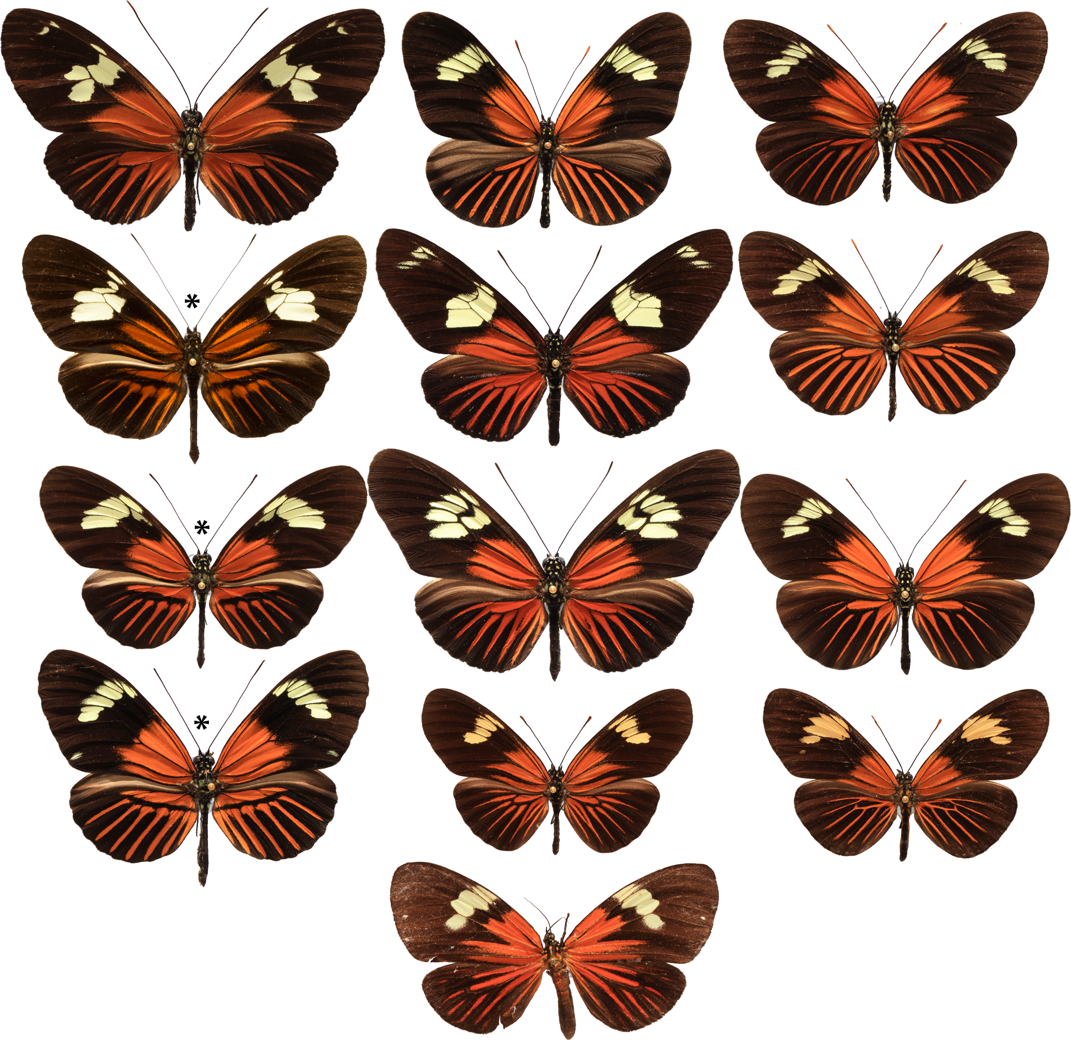

Slide 4
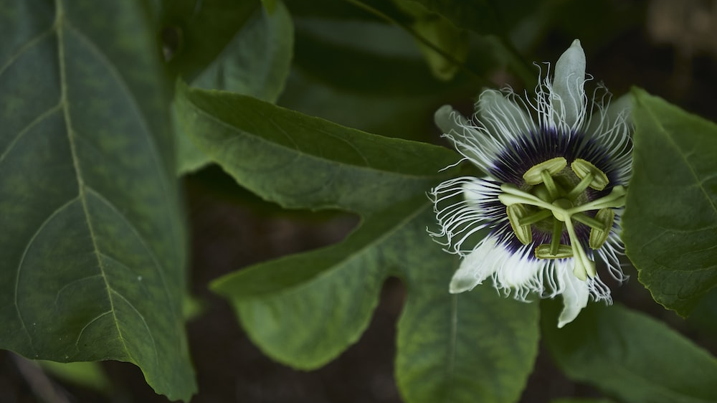
Notes:
Tim Sheerman-Chase: https://www.flickr.com/photos/tim_uk/51365852590/in/photolist-2mg2qq7-8QLAWW-Wd5FzH-2nLWnZp-53D6pf-kP1D3r-UJgPL3-2iu5CT6-53yNBM-2iB6zTE-53D47N-53D4J9-sc7aeo-53D25E-kP1sGt-53yNc6-53yMMr-qCuMF-2ik9dxm-KzecLe-2iu8cCJ-DzuhyF-eN73jm-2hzpX6b-LsNtnB-2h5iv8B-2iDTQce-7AgbBT-FVVD1B-KtDmeS-rK6y9c-WVi9ug-2n22jDz-2mYACUY-qoxm4X-2dQwCtW-2iZRKa8-iHUrF8-R5785G-jiVTeq-oHYtTy-2mYtYcx-2iqjGkv-dSNwaM-NrE9ds-6UBPy2-2hbgBxU-Q5ekWg-a8tgW1-HDFxVn
Judy Gallagher: https://www.flickr.com/photos/52450054@N04/48212550062/in/photolist-2gsnVr9-2g9yJML-8Yt54m-2ke5X6n-2iu5CRY-ax6zwD-oQm65m-uaP4mT-6UAq47-2gbT9xw-2iB6ERW-4C8fHr-2izZBSG-8j5hzK-2nGP5Tz-xooDqA-2i6Ausr-2hNTShg-239ieqr-oJtBLP-2jRDPVQ-2k9X7oW-2hNXu99-279PBhw-2gbTFf4-2hp1Ju2-2ibabH8-2hoKpXv-6xAgcC-2ibdCZu-B8yyM9-6UG4wu-2mYzpeh-27eAHZL-2mg2qq7-8QLAWW-Wd5FzH-2nLWnZp-53D6pf-kP1D3r-UJgPL3-2iu5CT6-53yNBM-2iB6zTE-53D47N-53D4J9-sc7aeo-53D25E-kP1sGt-53yNc6

Slide 5
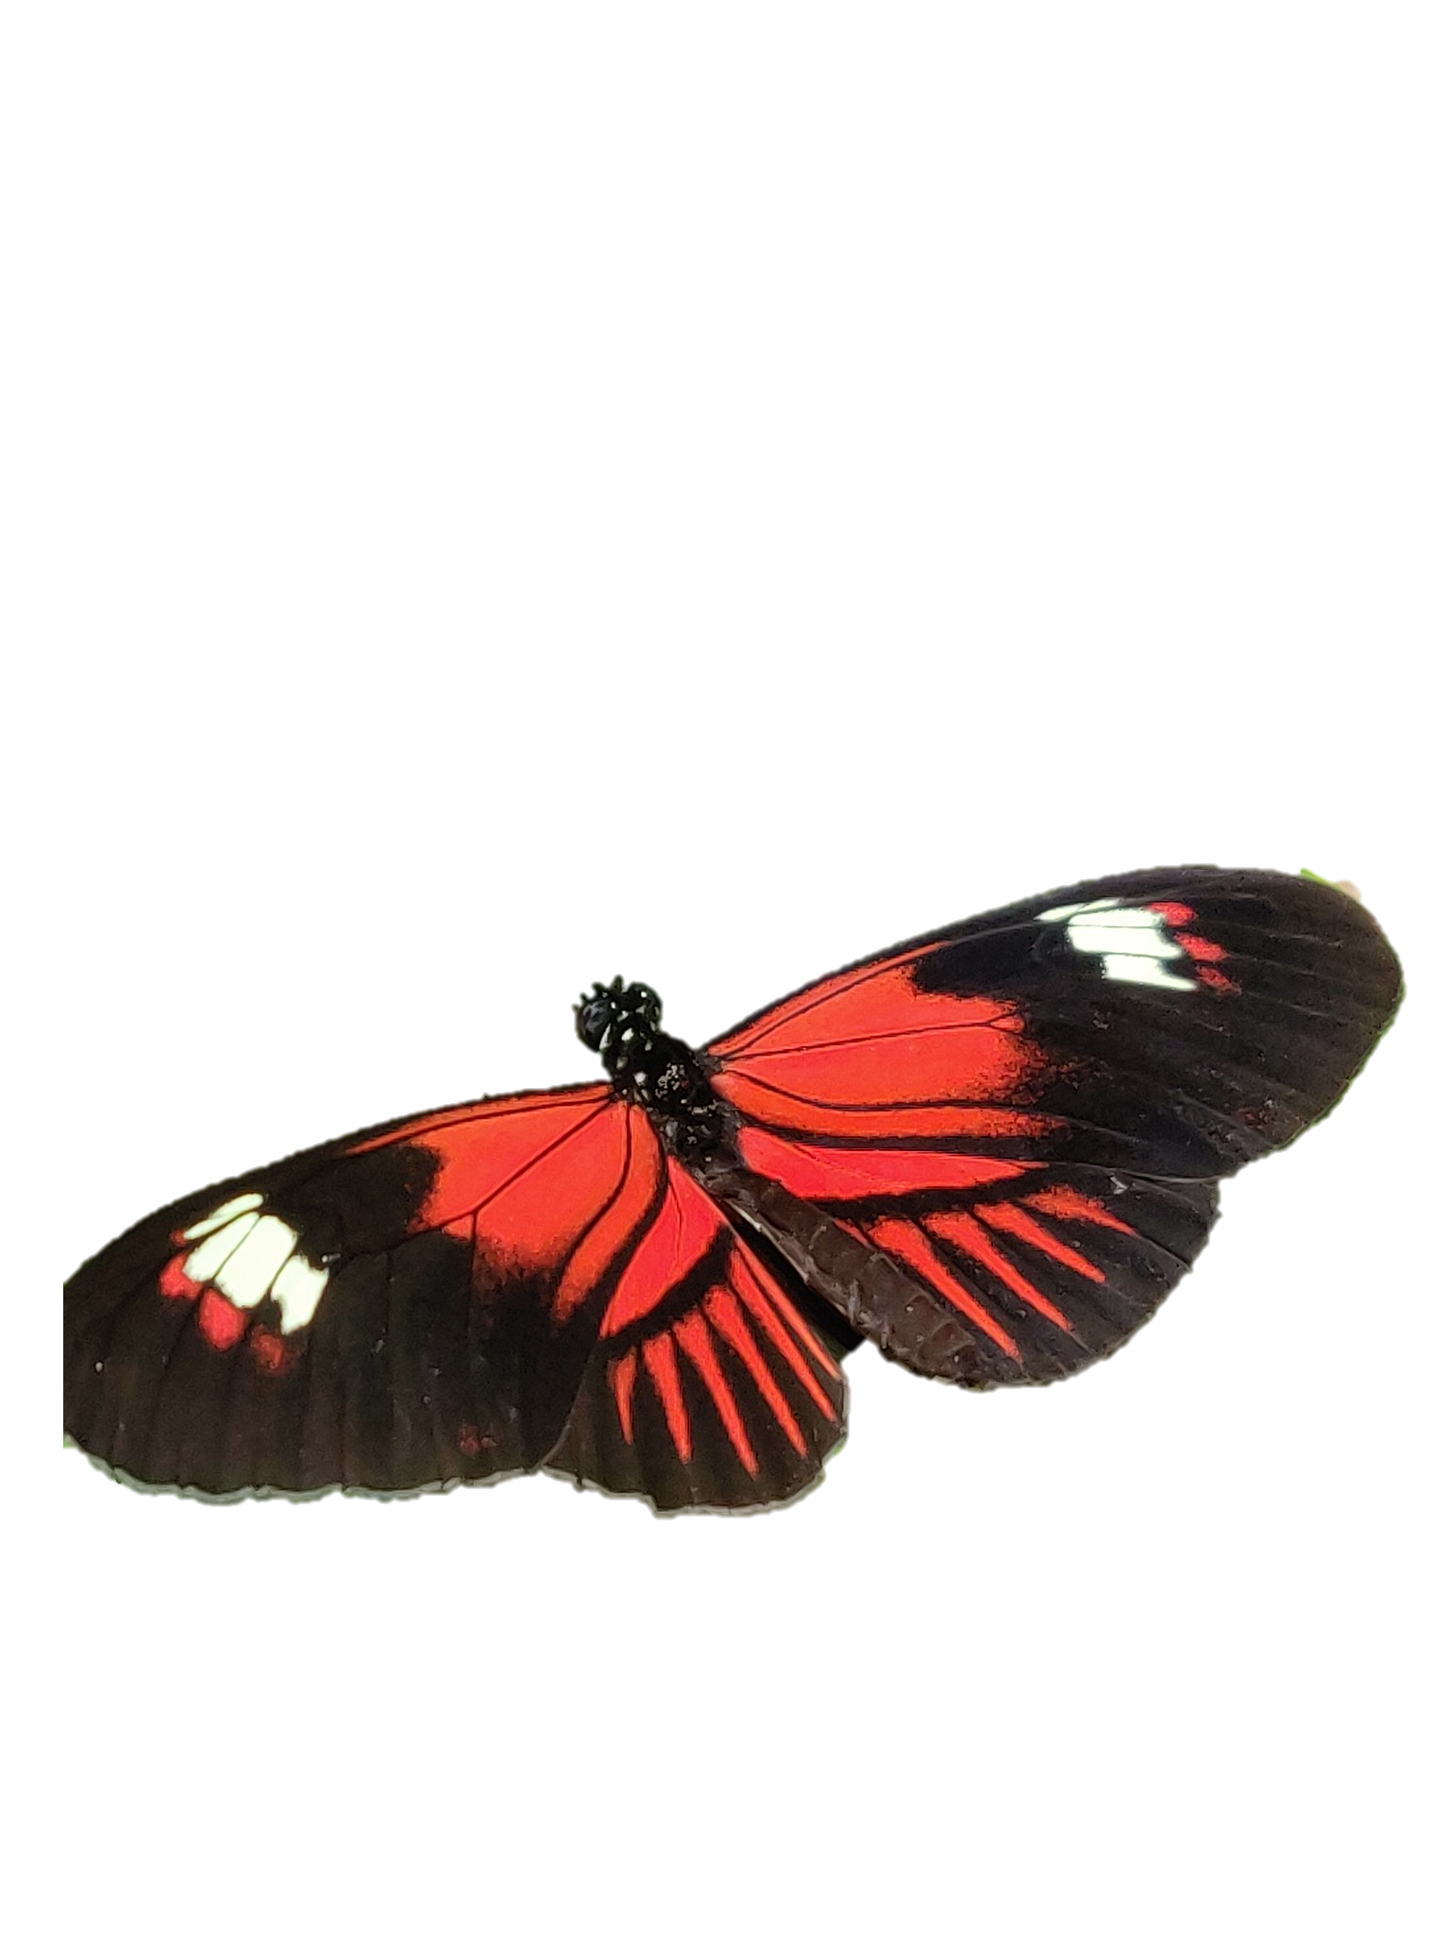

Slide 6
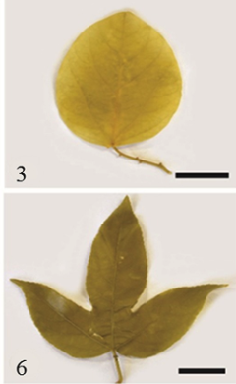

Slide 7
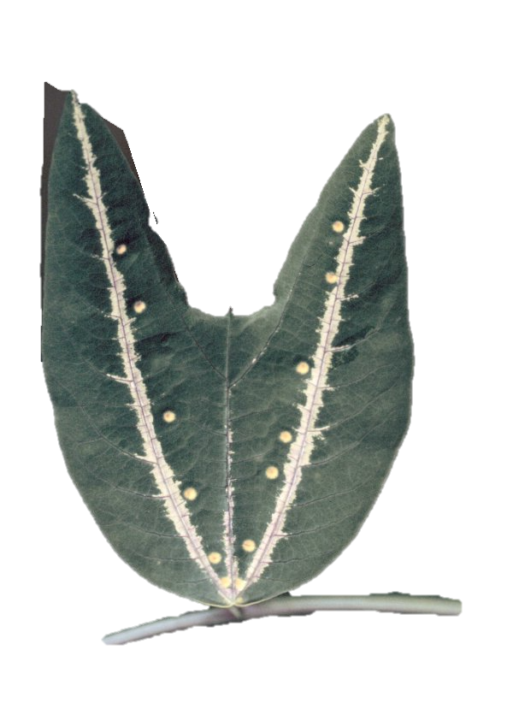

Slide 8
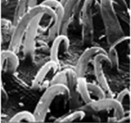
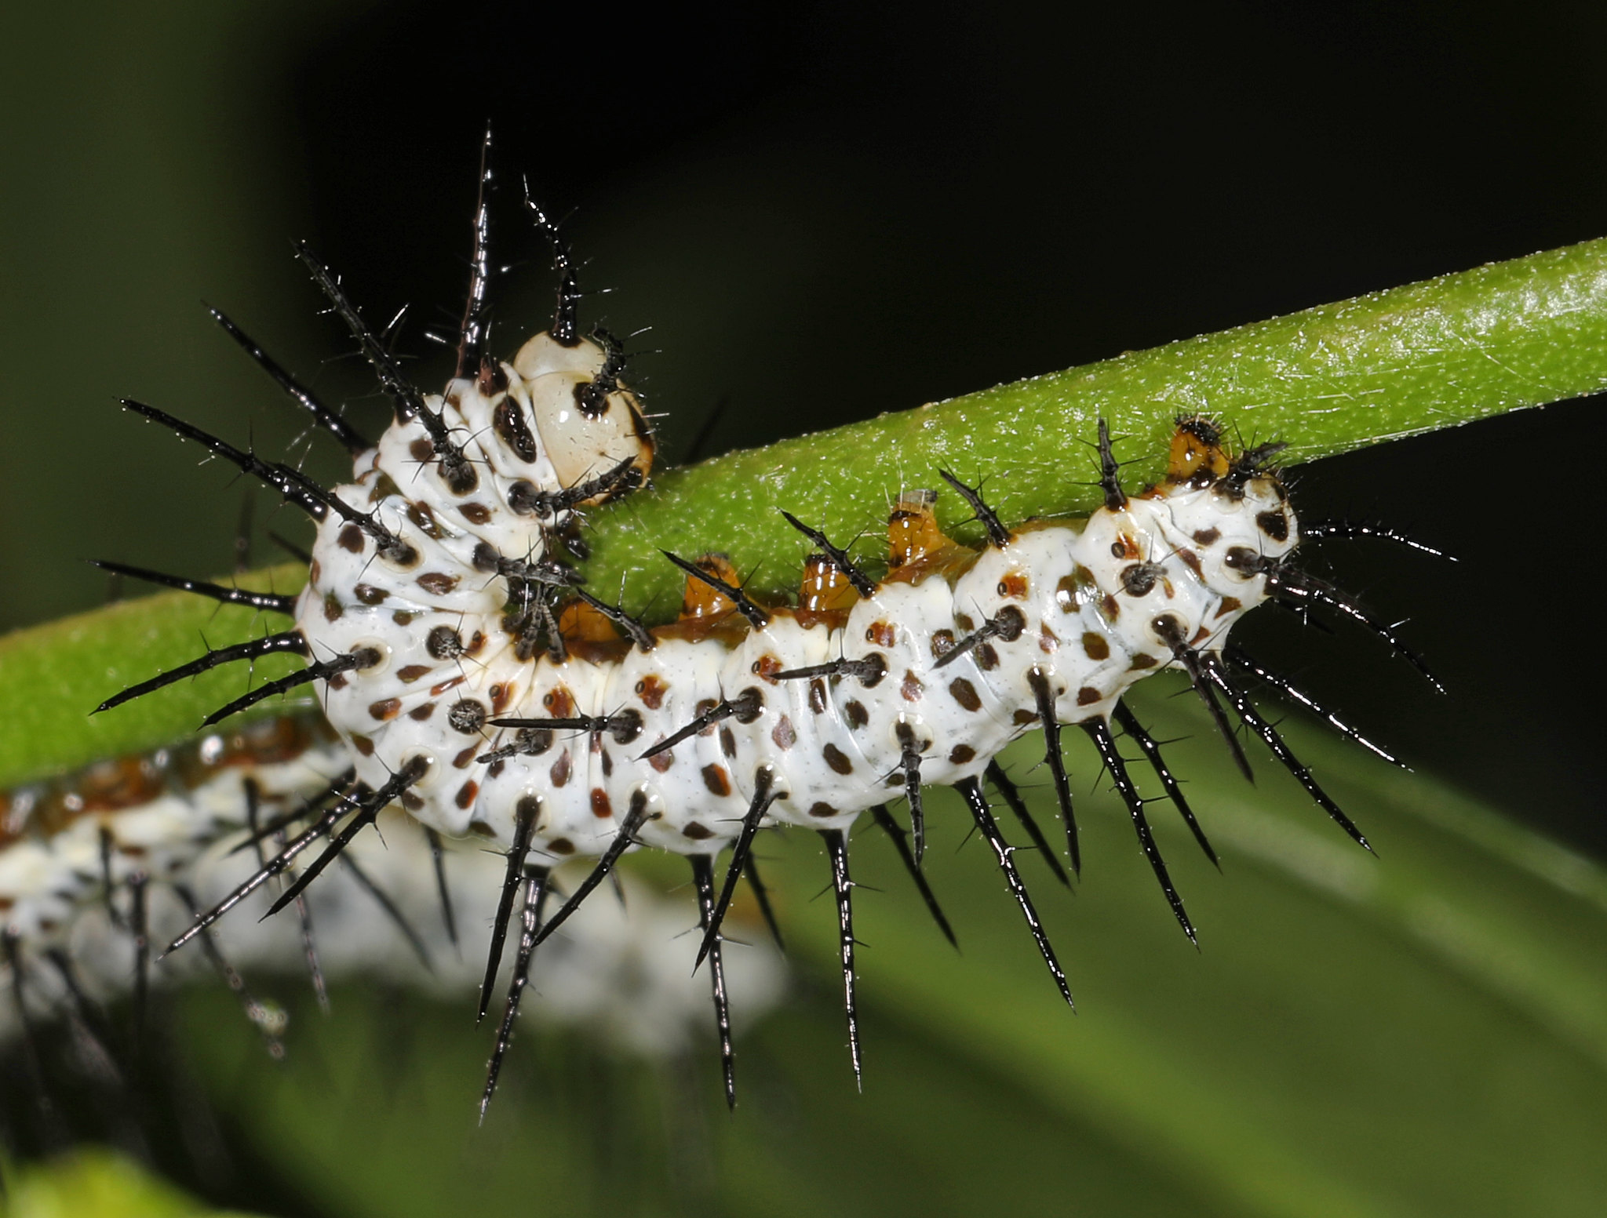

Slide 9
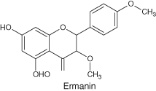
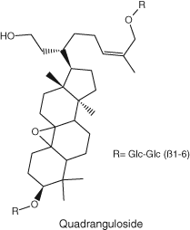
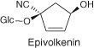
Notes:
Tim Sheerman-Chase: https://www.flickr.com/photos/tim_uk/51365852590/in/photolist-2mg2qq7-8QLAWW-Wd5FzH-2nLWnZp-53D6pf-kP1D3r-UJgPL3-2iu5CT6-53yNBM-2iB6zTE-53D47N-53D4J9-sc7aeo-53D25E-kP1sGt-53yNc6-53yMMr-qCuMF-2ik9dxm-KzecLe-2iu8cCJ-DzuhyF-eN73jm-2hzpX6b-LsNtnB-2h5iv8B-2iDTQce-7AgbBT-FVVD1B-KtDmeS-rK6y9c-WVi9ug-2n22jDz-2mYACUY-qoxm4X-2dQwCtW-2iZRKa8-iHUrF8-R5785G-jiVTeq-oHYtTy-2mYtYcx-2iqjGkv-dSNwaM-NrE9ds-6UBPy2-2hbgBxU-Q5ekWg-a8tgW1-HDFxVn
Judy Gallagher: https://www.flickr.com/photos/52450054@N04/48212550062/in/photolist-2gsnVr9-2g9yJML-8Yt54m-2ke5X6n-2iu5CRY-ax6zwD-oQm65m-uaP4mT-6UAq47-2gbT9xw-2iB6ERW-4C8fHr-2izZBSG-8j5hzK-2nGP5Tz-xooDqA-2i6Ausr-2hNTShg-239ieqr-oJtBLP-2jRDPVQ-2k9X7oW-2hNXu99-279PBhw-2gbTFf4-2hp1Ju2-2ibabH8-2hoKpXv-6xAgcC-2ibdCZu-B8yyM9-6UG4wu-2mYzpeh-27eAHZL-2mg2qq7-8QLAWW-Wd5FzH-2nLWnZp-53D6pf-kP1D3r-UJgPL3-2iu5CT6-53yNBM-2iB6zTE-53D47N-53D4J9-sc7aeo-53D25E-kP1sGt-53yNc6

Slide 10
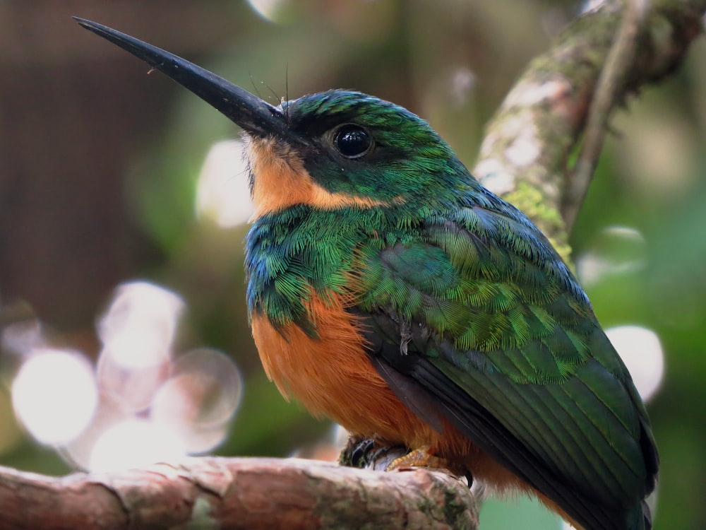


Slide 11
Notes:
Diversity of the Amazonian dennis-ray mimicry ring.First row: H. burneyi huebneri, H. aoede auca, and H. xanthocles zamora; second row: H. timareta timareta f. timareta, H. doris doris, and H. demeter ucayalensis; third row: H. melpomene malleti, H. egeria homogena, and H. erato emma; fourth row: H. elevatus pseudocupidineus, Eueides heliconioides eanes, and E. tales calathus; and bottom: Chetone phyleis, a pericopine moth. Stars indicate the three species that are the focus of this study. Butterflies figured are from the Neukirchen Collection, McGuire Centre, Florida. The butterflies are from populations in both Ecuador and Peru. show less
https://journals.plos.org/plosbiology/article?id=10.1371/journal.pbio.1002353

Slide 12
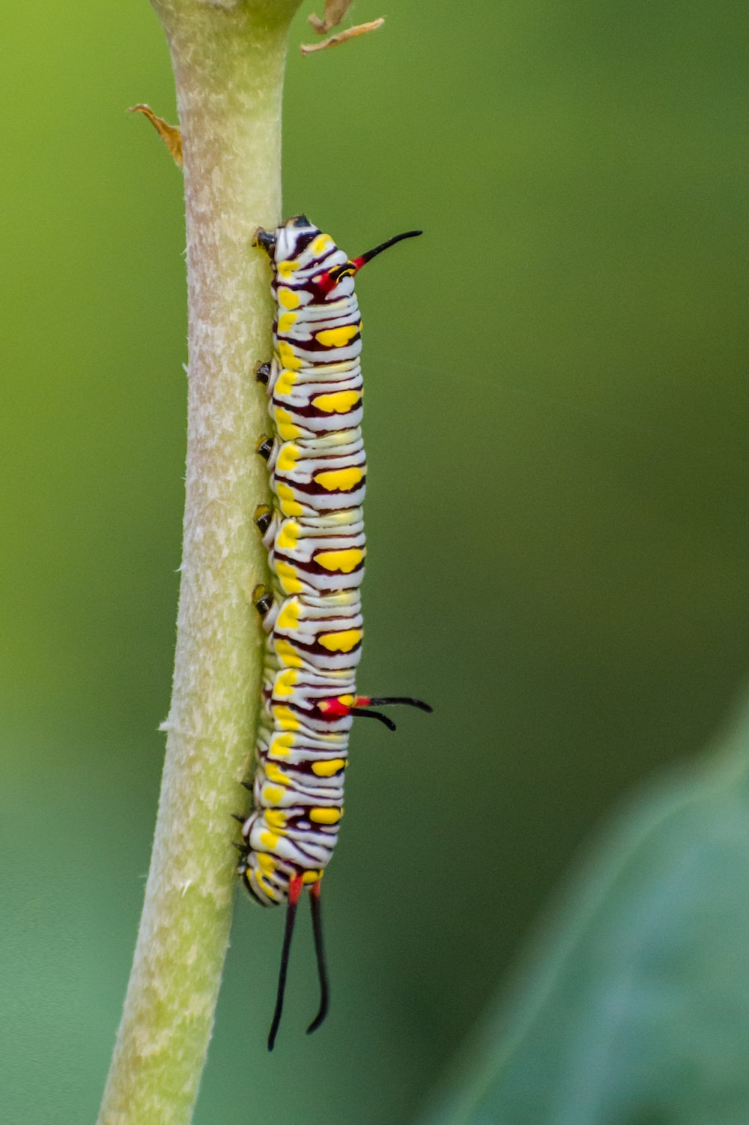
Coevolution
Interactions between Species Lead to Diversification
Notes:
Plants evolve defenses……their consumers evolve ways around them. aka coevolution
The result is (often )specialization and speciation
A caterpillar of the Plain Tiger Butterfly on a branch at a forest area in Mumbai, India
https://unsplash.com/photos/sCECxmn0HMY

Slide 13
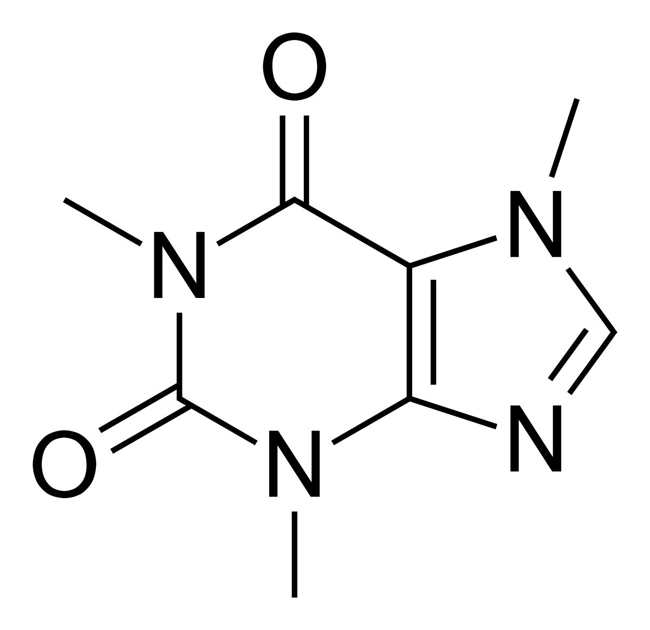
Chemical Defenses
Notes:
Loads of them: over 100K identified to date
A single plant species (e.g., tomato) can have 100’s
Alkaloids Non-protein Amino Acids
Cyanogens Coumarins
Terpenoids Cardenolides
Iridoid glycosides
Glucosinolates (e.g., mustard oils)

Slide 14

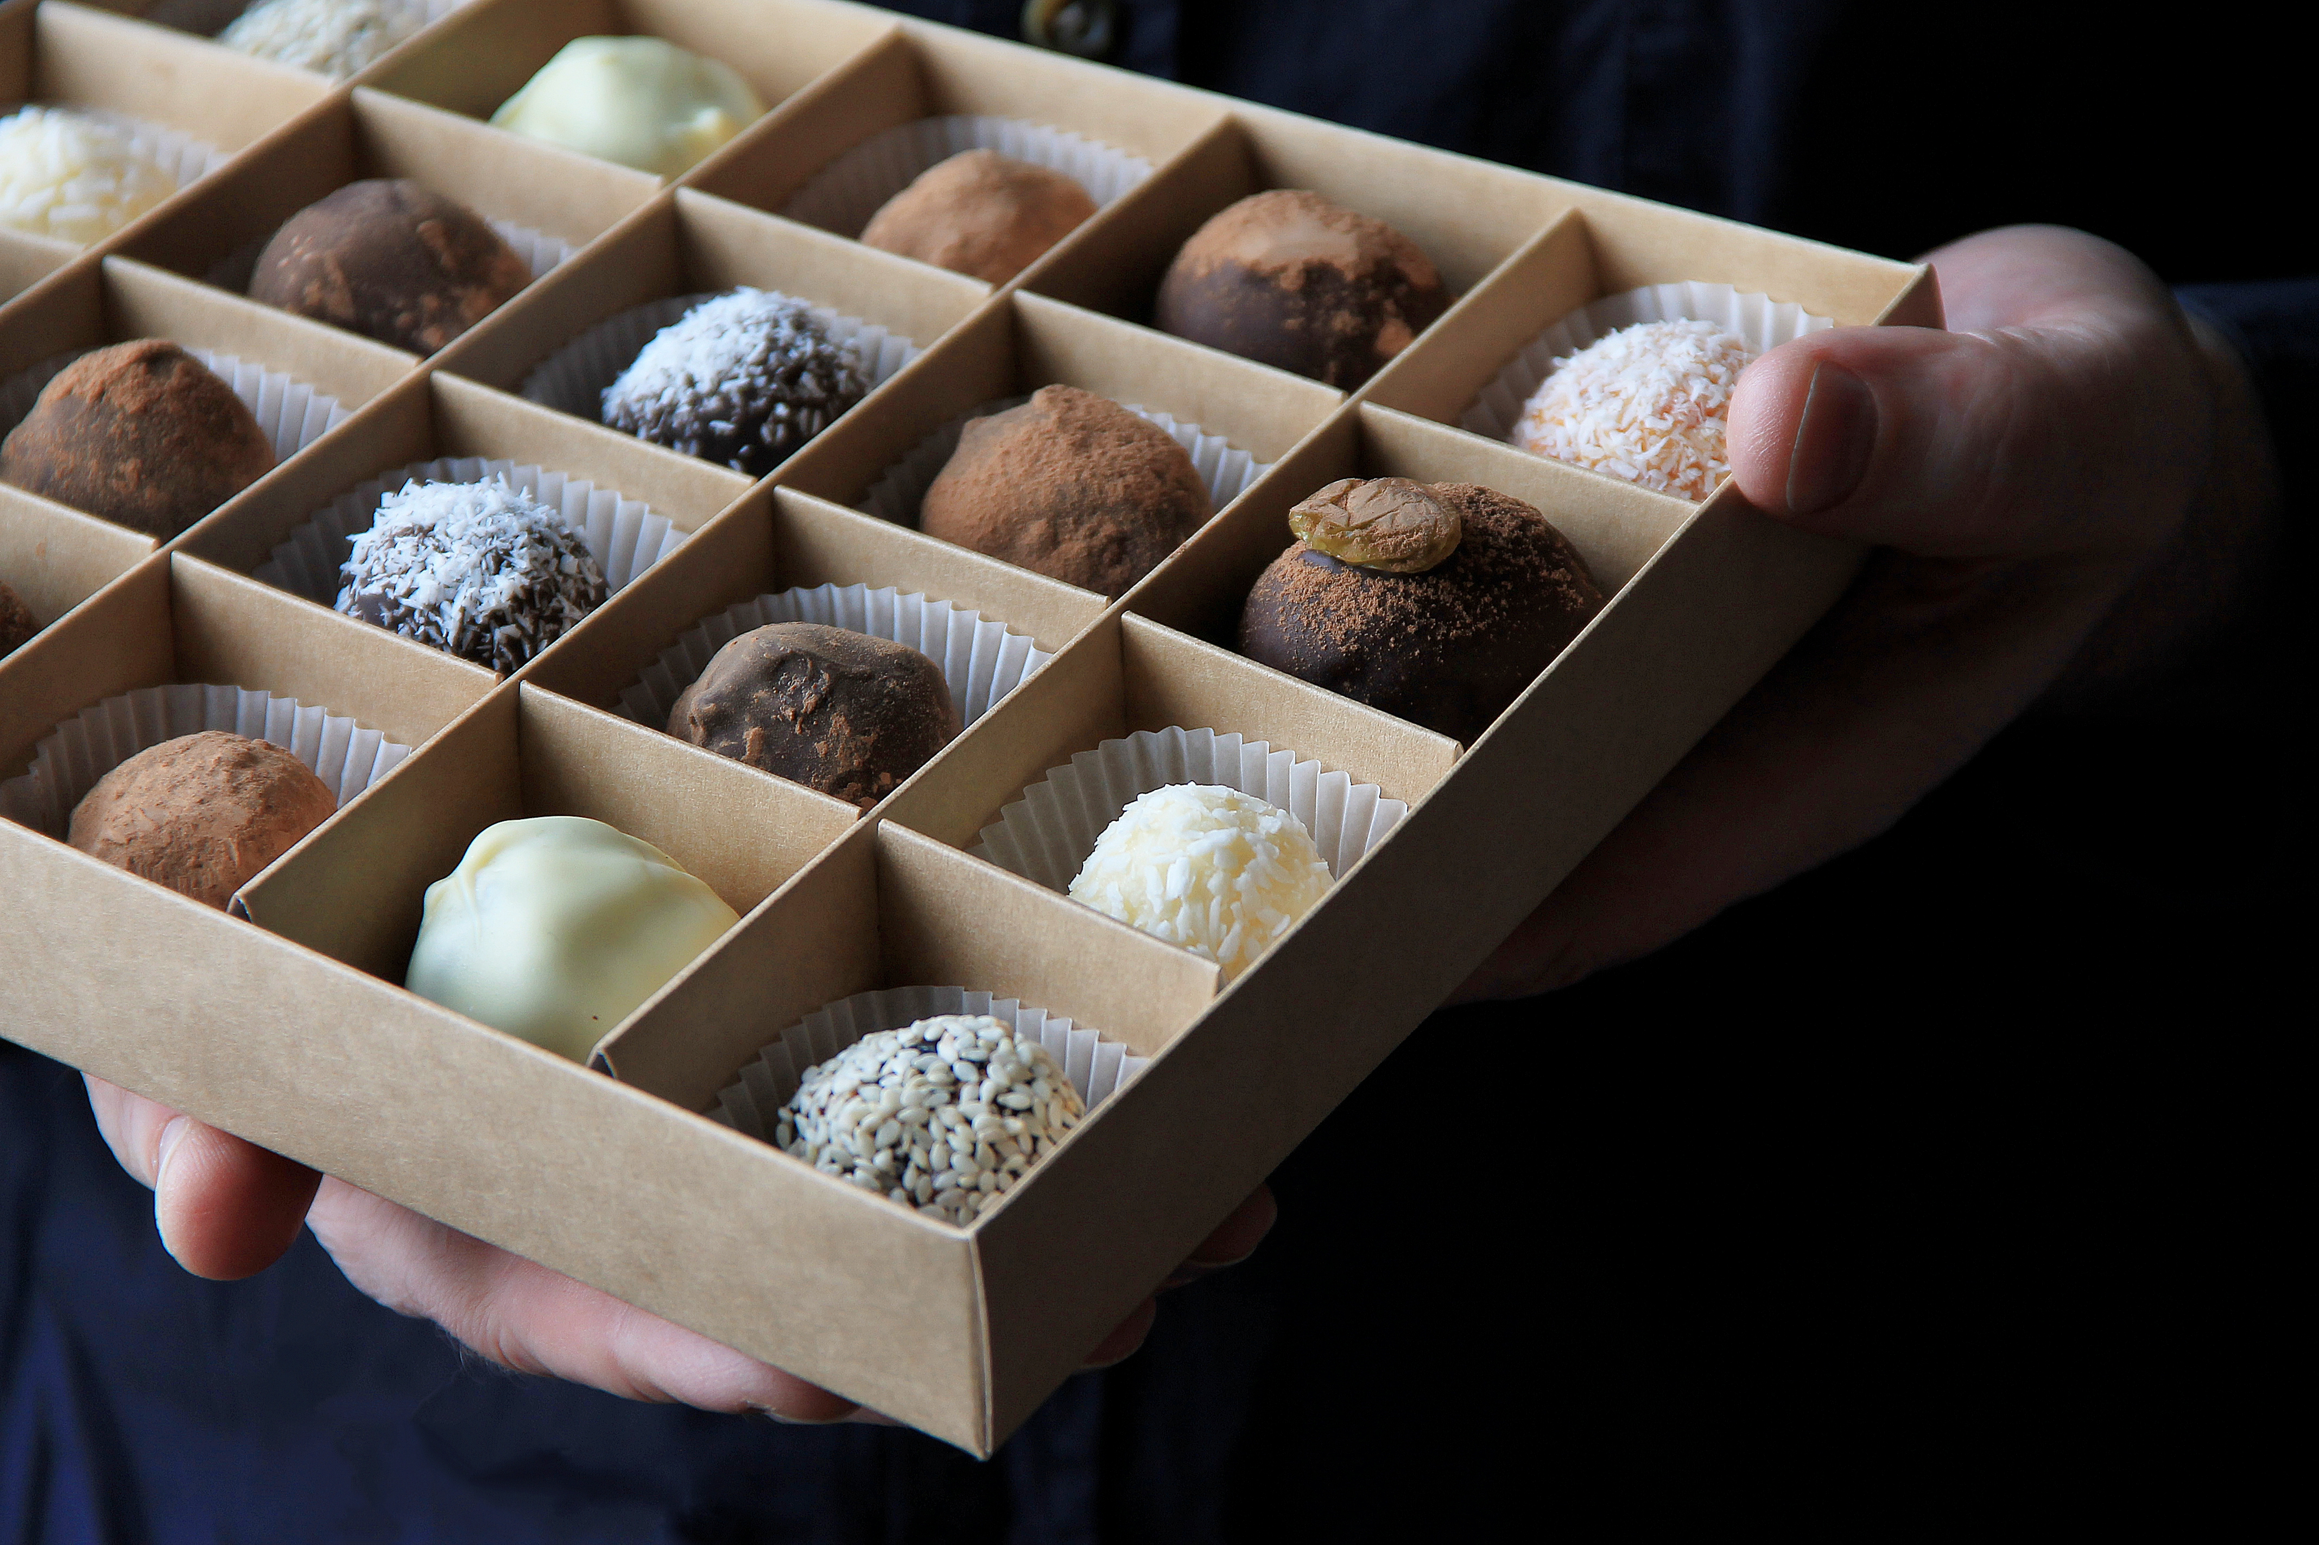
Tannins: deter herbivores with bitter taste, bind to proteins/render them indigestible
Notes:
Digestibility reducers

Slide 15

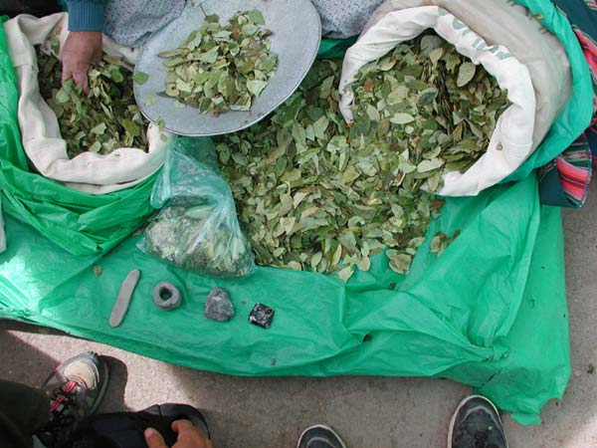
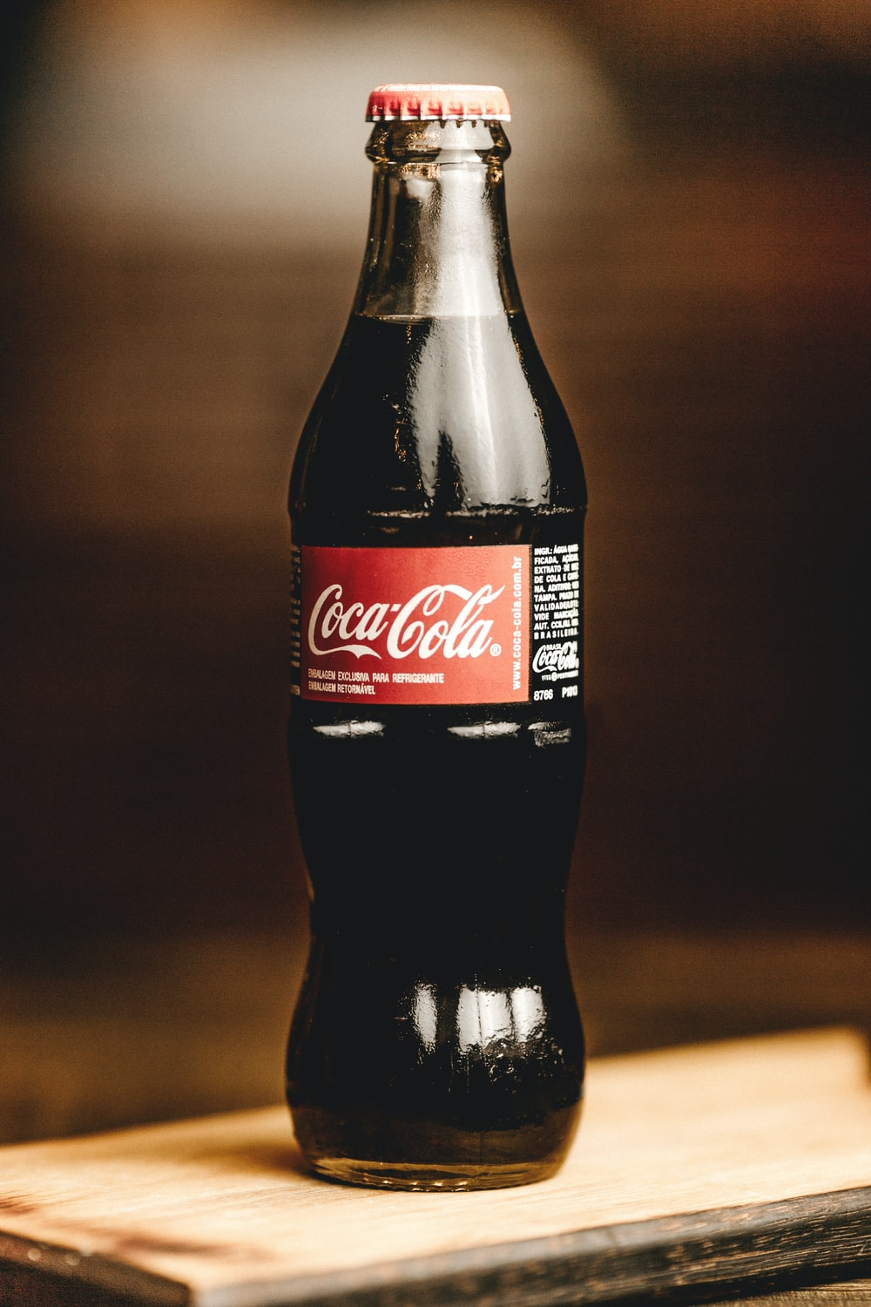
Nitrogen-containing compounds synthesized from amino acids
Alkaloids (heterocyclic rings with nitrogen)
Coca leaves
Notes:
Abundant & Diverse: in 20% of plants
Nicotine, caffeine, cocaine, morphine / opiates, mescaline, mustard oils
Affect nervous system, (stimulants, depressants, psychoactive effects)
Inhibit RNA/DNA synthesis
Feeding inhibitors (often bitter);
Blocks signal transmission in nervous system (Acetylcholinesterase)
Some (e.g., pyrrolizidine alkaloids) not toxic until converted to toxic form by enzymes in liver.

Slide 16
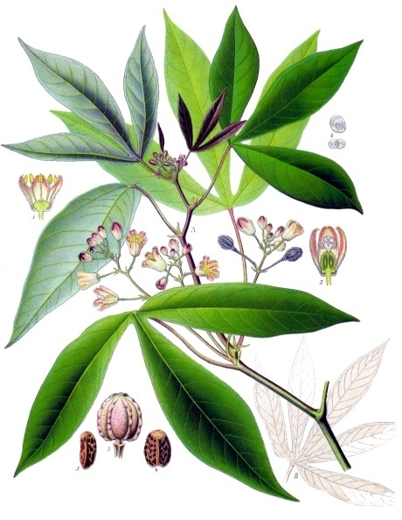
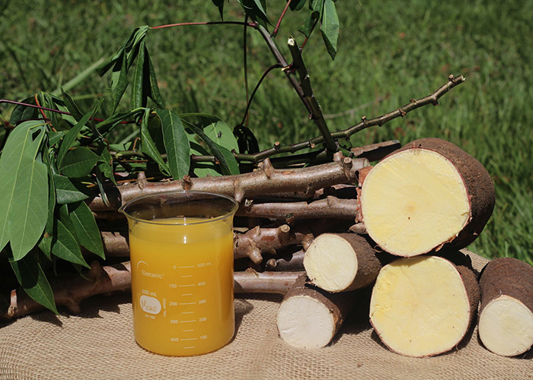
Cyanogenic compounds
Manihot esculenta
Notes:
Molecules containing cyanide (HCN)
Often highly compartmentalized (duh)
HCN released when tissues damaged
Inhibits electron transport / cellular respiration (creation of ATP)

Slide 17
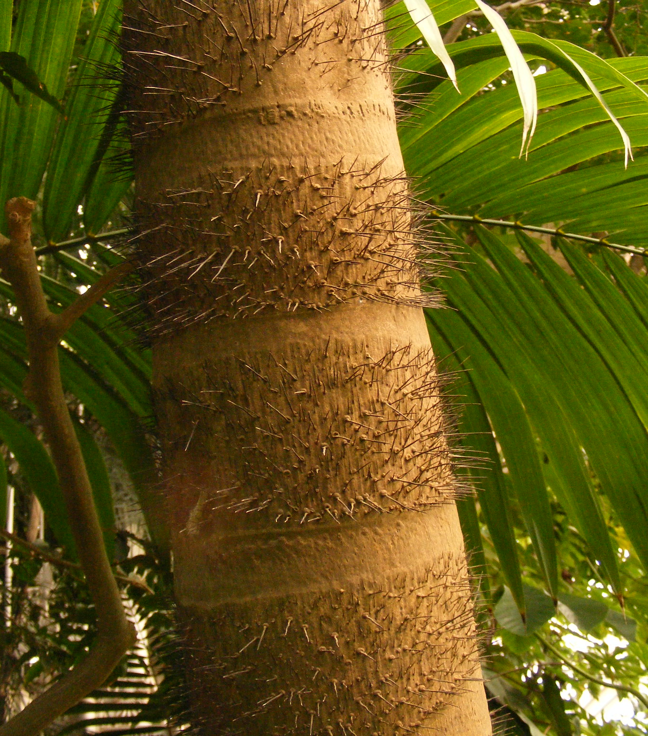
Physical Defenses
Notes:
https://www.flickr.com/photos/archimandrill/3028878891/in/photolist-5BDNaR-xsUg2d-owsqGj-2hQjNUm-EQVWra-xbHDkS-xNxVdH-2hQkPoB-tCAwnZ-x3LDUh-ow9qhE-2hQjMxU-rpkXN2-xBQ9ZN-xBVZgZ-7fuKzQ-x9b4dG-y3yABu-y6c9wg-xNind5-xesQ4r-y5mdou-y3KEpo-wGrpYj-9Q1RYc-x9pvzT-dJvj8q-RMAYMp-r62y32-y5iqbn-qtz7hy-y4CkTX-x3Dc29-xNAspG-y3tQF1-ouzmYA-y57beC-y4SNQm-x8YbDh-y5nqwW-xZSANH-y6XKdP-y5qzRG-x8ZWi8-Fm1Vs-y6rZNk-y4TKFJ-oujCVj-y4Tzbf-y5Kizt

Slide 18
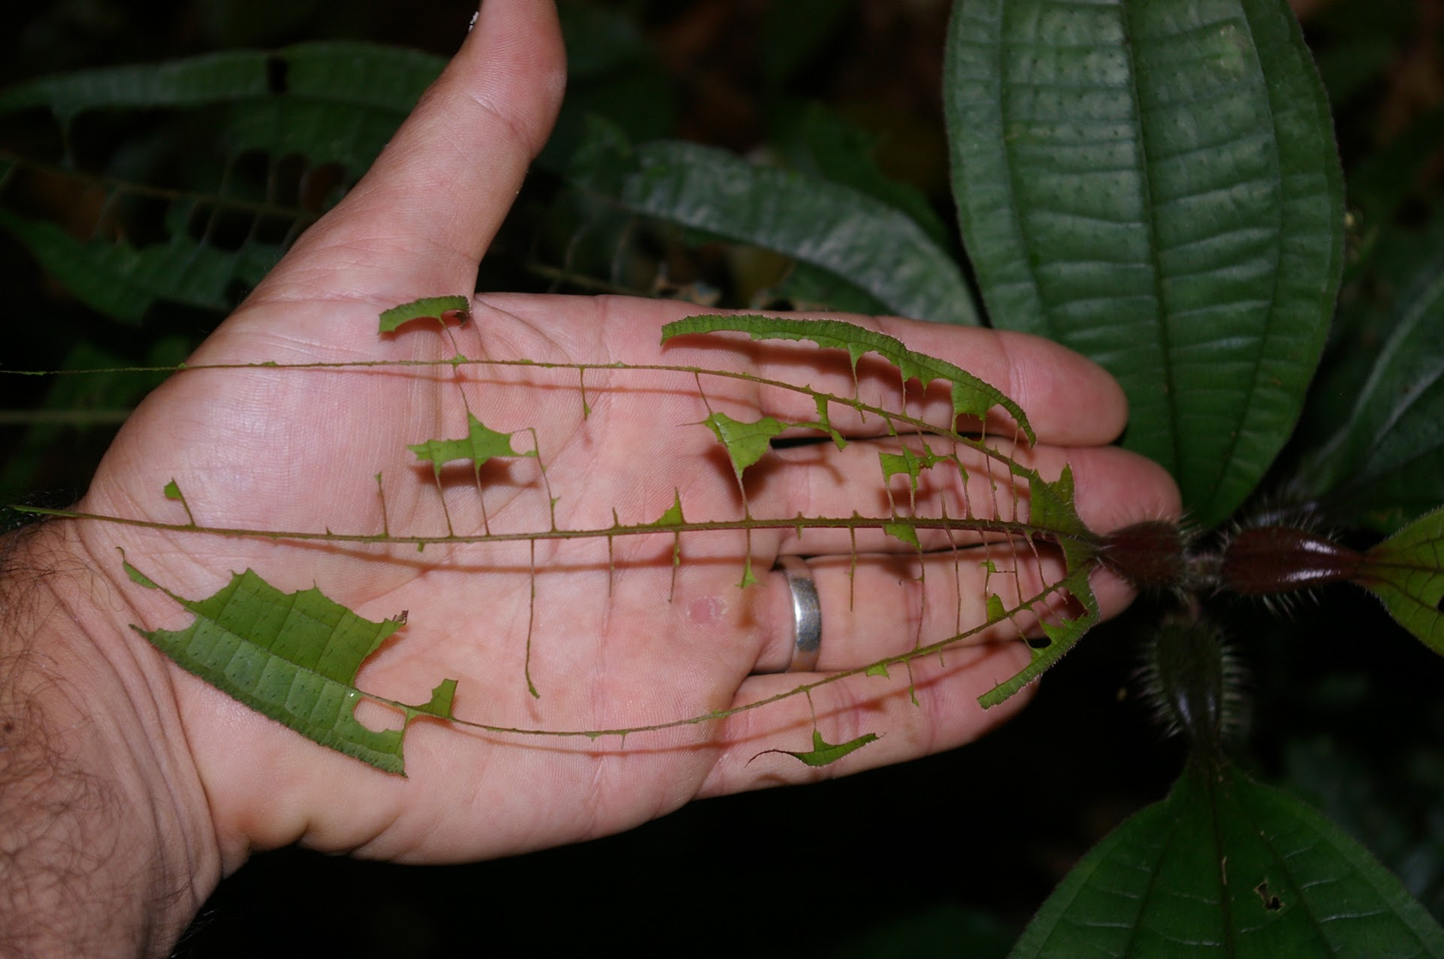
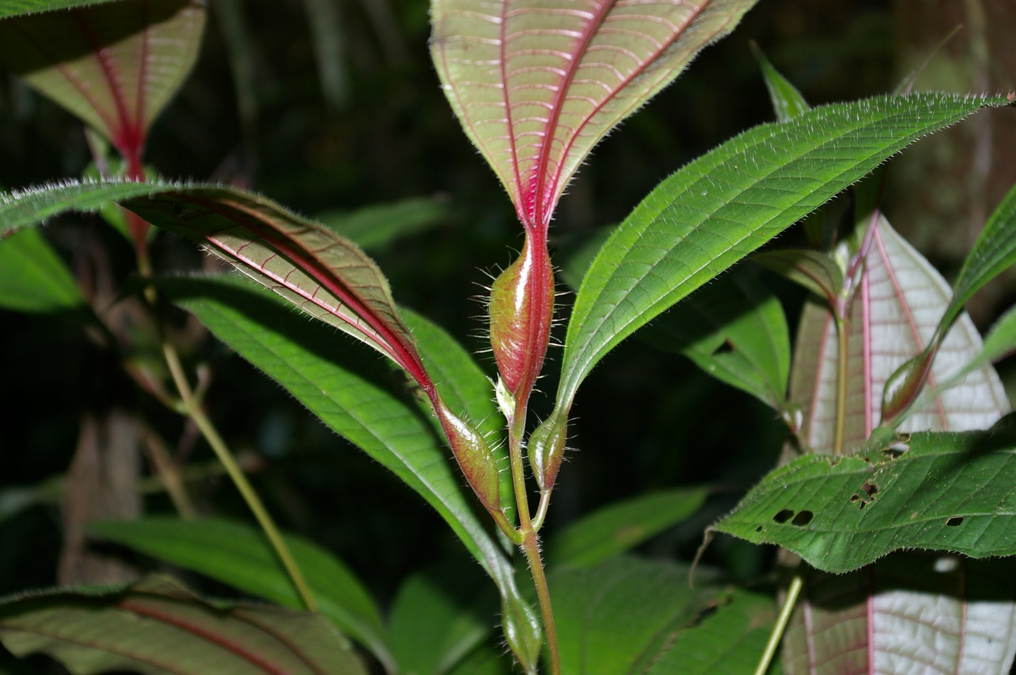
Biotic Defenses
Notes:
https://www.flickr.com/photos/archimandrill/3028878891/in/photolist-5BDNaR-xsUg2d-owsqGj-2hQjNUm-EQVWra-xbHDkS-xNxVdH-2hQkPoB-tCAwnZ-x3LDUh-ow9qhE-2hQjMxU-rpkXN2-xBQ9ZN-xBVZgZ-7fuKzQ-x9b4dG-y3yABu-y6c9wg-xNind5-xesQ4r-y5mdou-y3KEpo-wGrpYj-9Q1RYc-x9pvzT-dJvj8q-RMAYMp-r62y32-y5iqbn-qtz7hy-y4CkTX-x3Dc29-xNAspG-y3tQF1-ouzmYA-y57beC-y4SNQm-x8YbDh-y5nqwW-xZSANH-y6XKdP-y5qzRG-x8ZWi8-Fm1Vs-y6rZNk-y4TKFJ-oujCVj-y4Tzbf-y5Kizt

Slide 19
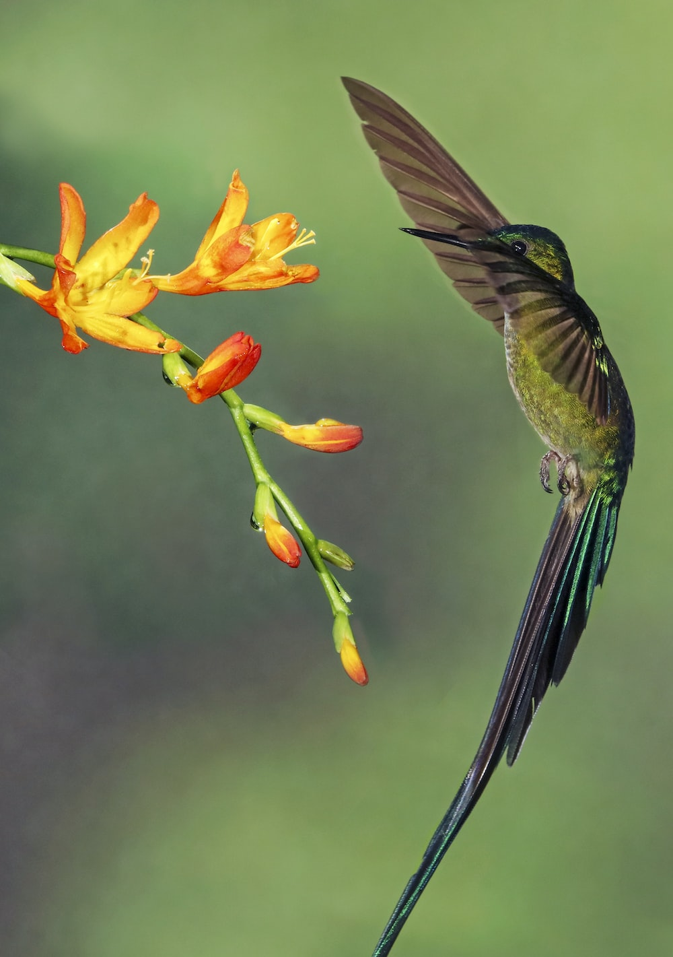
Coevolution
Interactions between Species Lead to Diversification
Notes:
Plants evolve defenses……their consumers evolve ways around them. aka coevolution
The result is (often )specialization and speciation
A Long-tailed Sylph in the gardens of Guango Lodge Ecuador
https://unsplash.com/photos/D72pC3JeOOk

Slide 20
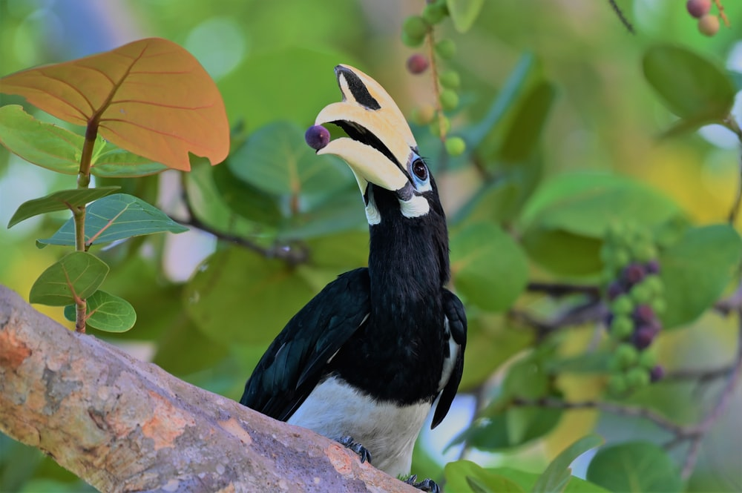
Coevolution
Interactions between Species Lead to Diversification
Notes:
Plants evolve defenses……their consumers evolve ways around them. aka coevolution
The result is (often )specialization and speciation
A Long-tailed Sylph in the gardens of Guango Lodge Ecuador
https://unsplash.com/photos/D72pC3JeOOk

Slide 21
The Future of Tropical Rain Forests (IDS 2935)
Disturbance &
The Paradox of Luxuriance

Slide 22
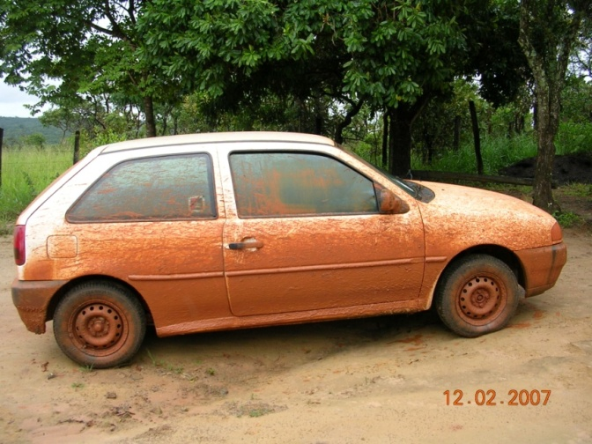
It all comes down to
SOIL

Slide 23
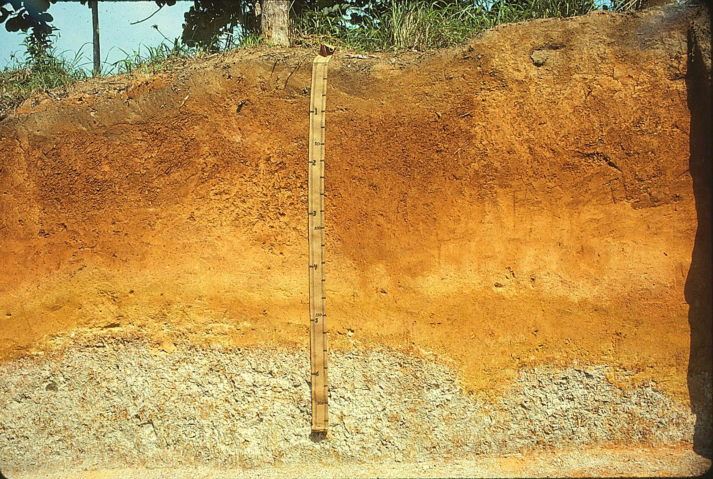
Soil
Layer of chemically and biologically altered material that overlies rock
Photo: Soil Science Typic Hapludult (fine-loamy, mixed, semiactive, isohyperthermic) In Loreto, Peru. (CC BY 2.0)
Notes:
Some people add the definition of supporting life for plants…mention recent argument over sediments and aquatic soils.

Slide 24
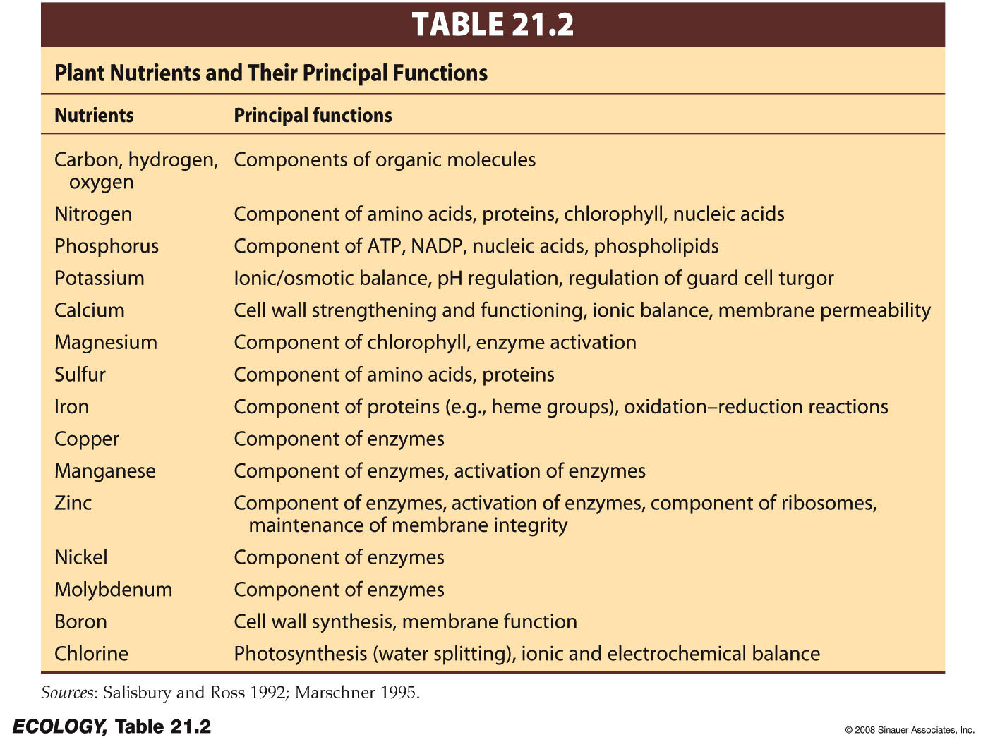
Soil Chemistry
Macronutrients: Needed in large amounts.
Micronutrients: Needed in trace amounts

Slide 25
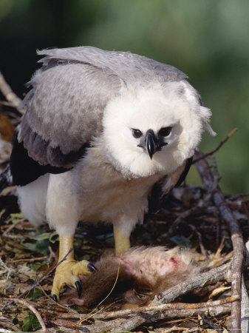
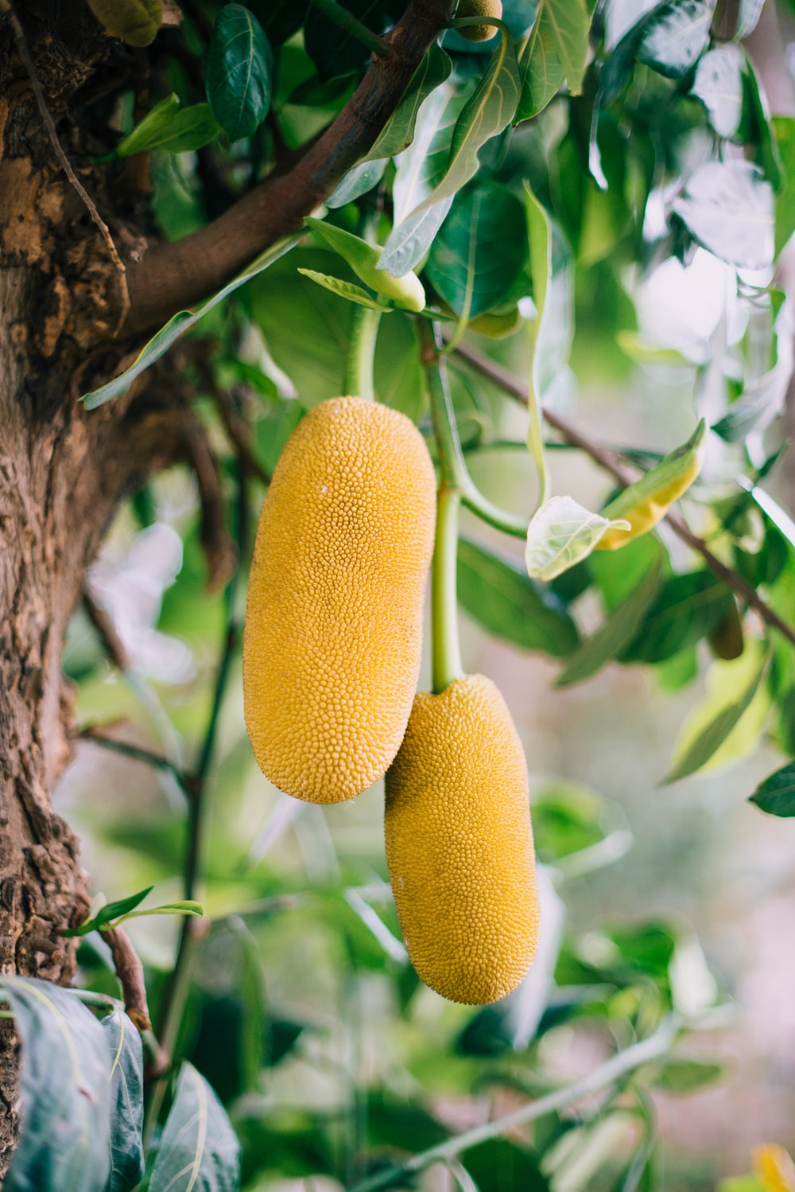
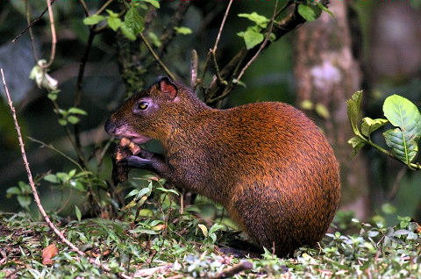
organisms at higher trophic levels get (most of) them from their food
Plants get nutrients from their environment

Slide 26
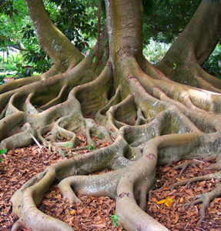
Nutrients must be present in simple, water soluble forms for plant roots to take them up
Ca²⁺
K⁺
Mg²⁺
Many of these are positively charged ions…this will be important later!
Nitrogen is the limiting nutrient in most tropical forests

Slide 27
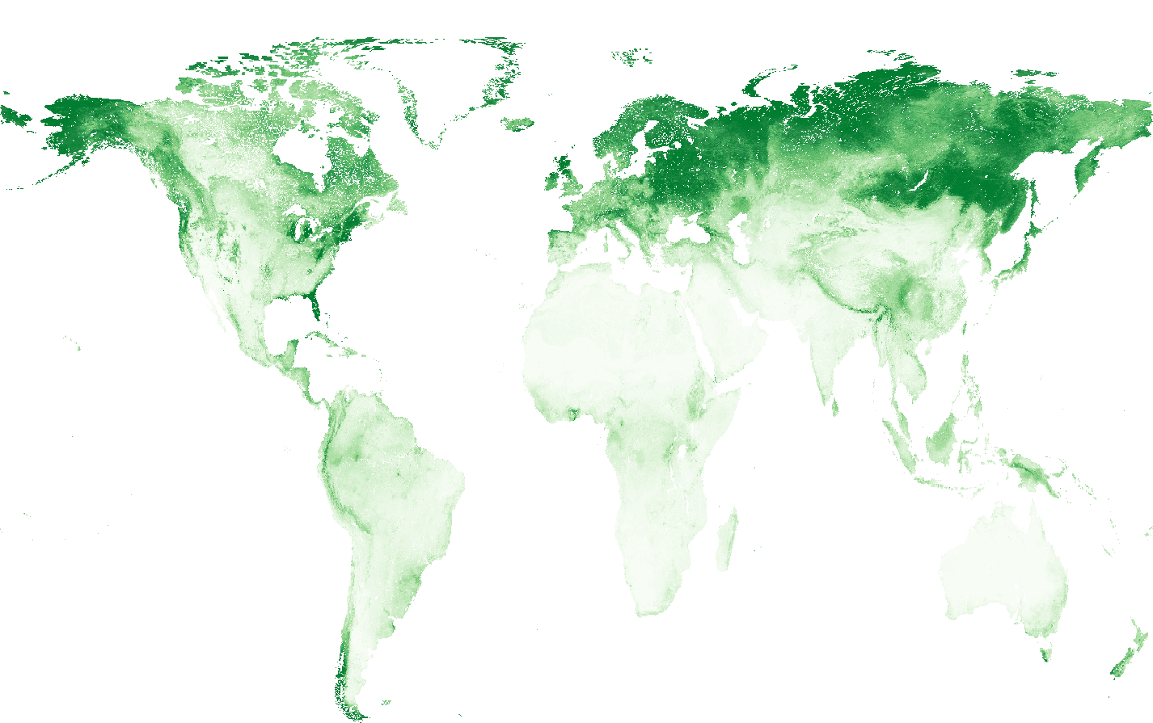
Total nitrogen
Notes:
https://data.isric.org/geonetwork/srv/api/records/f0797a68-1692-11ea-a7c0-a0481ca9e724

Slide 28
Sand
Silt
Clay
Maximum soil fertility: pH = 6.0-7.2.
Below about pH 5.5…nutrients leach out of the soil.

Slide 29
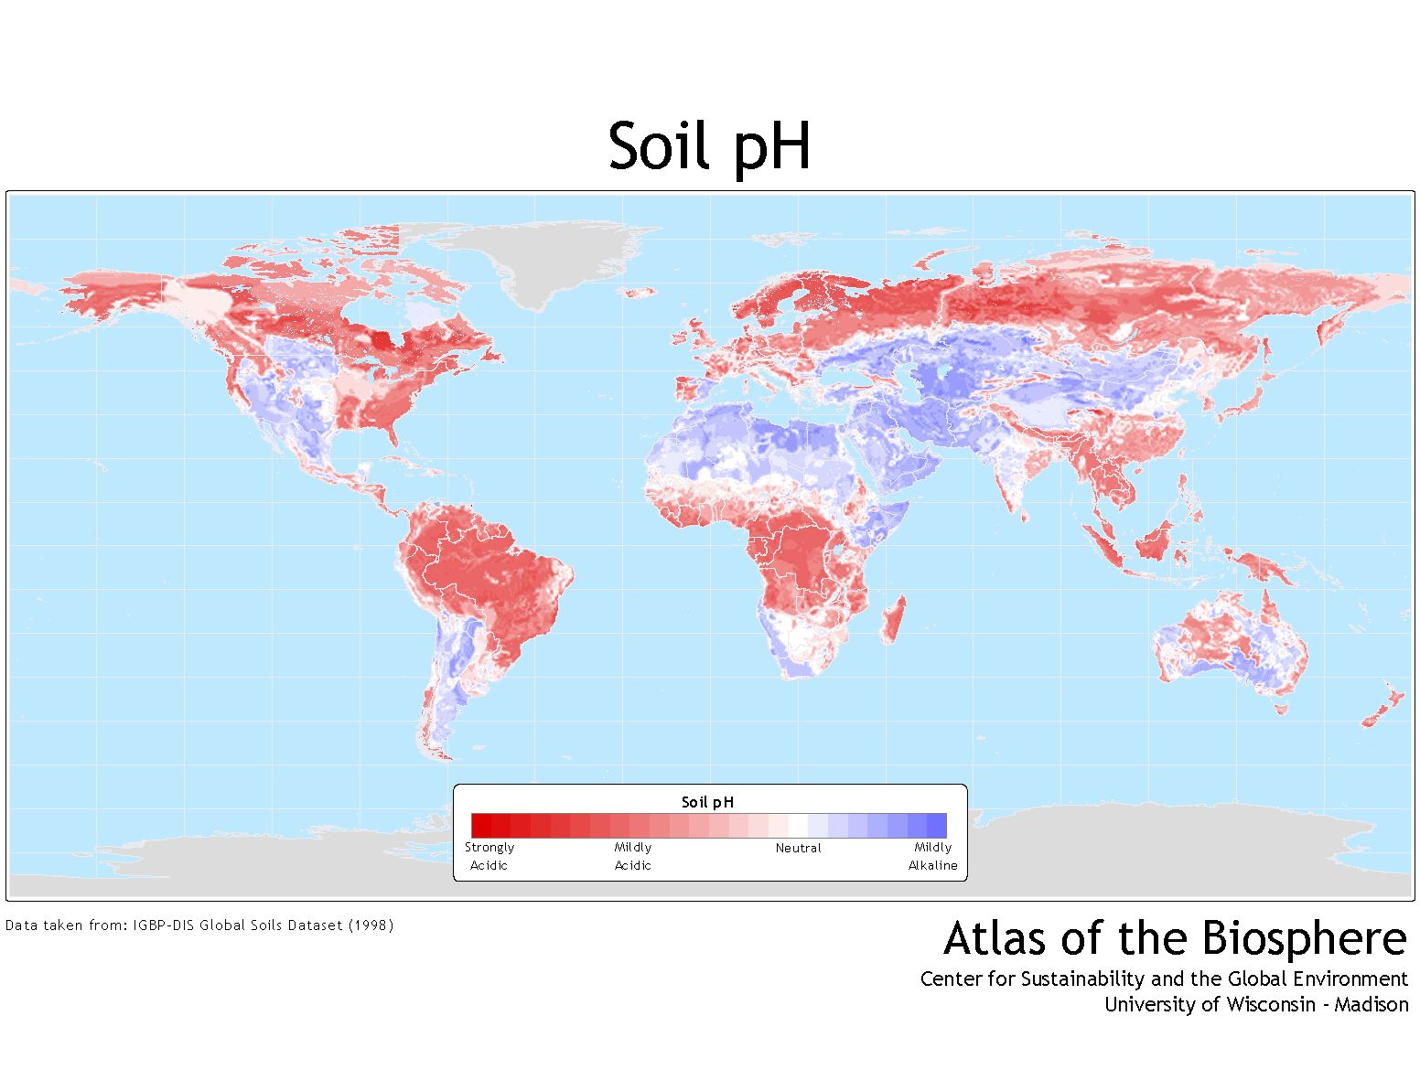
“Typical” tropical soil pH = 4.2-5.0

Slide 30
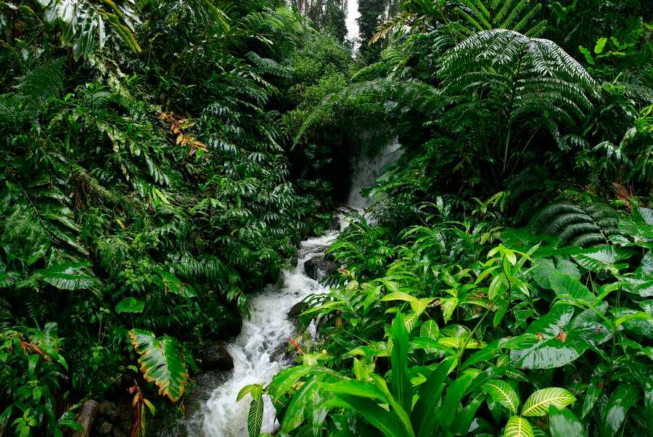
So if tropical soils are so terrible, where did all this productivity come from?
© copyright by Johnathan Esper

Slide 31
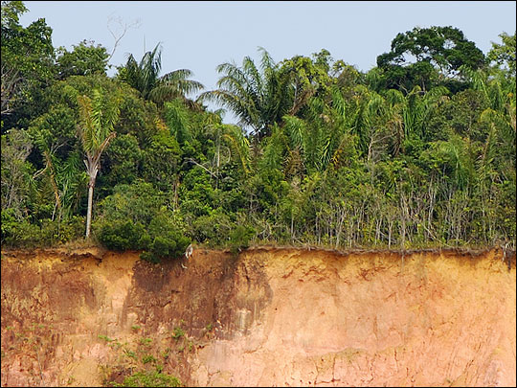
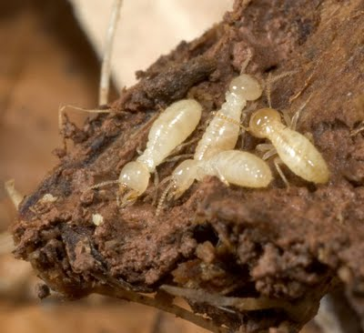
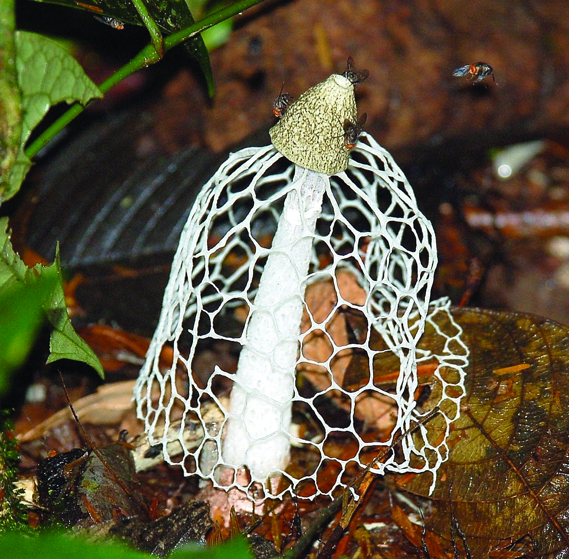
Most of the nutrients in Trop. Rain Forests are in the living (tree) biomass.

Slide 32
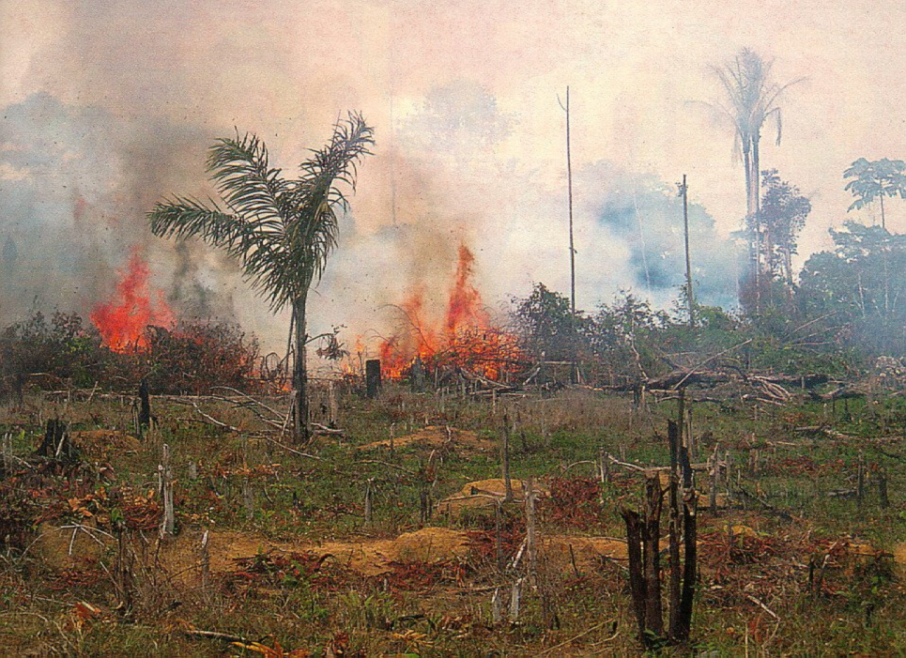
When tropical forests are cleared and burned, most nutrients are lost in smoke and ash and soil erosion.
If severe enough, these ecosystems can take centuries to return to their previous state.

Slide 33
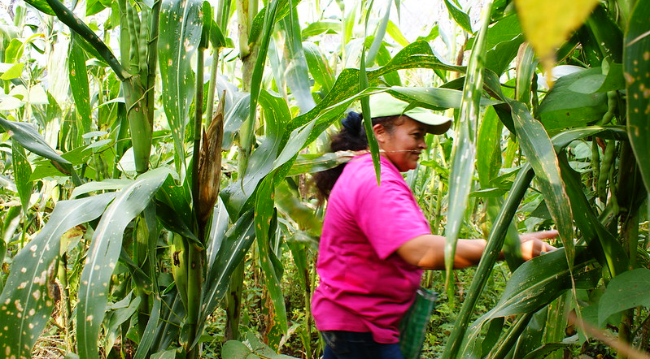
Photo by Feria de Productores: Maíz / Milpa
Tangamandapio, Michoacán (CC BY 2.0)

Slide 34
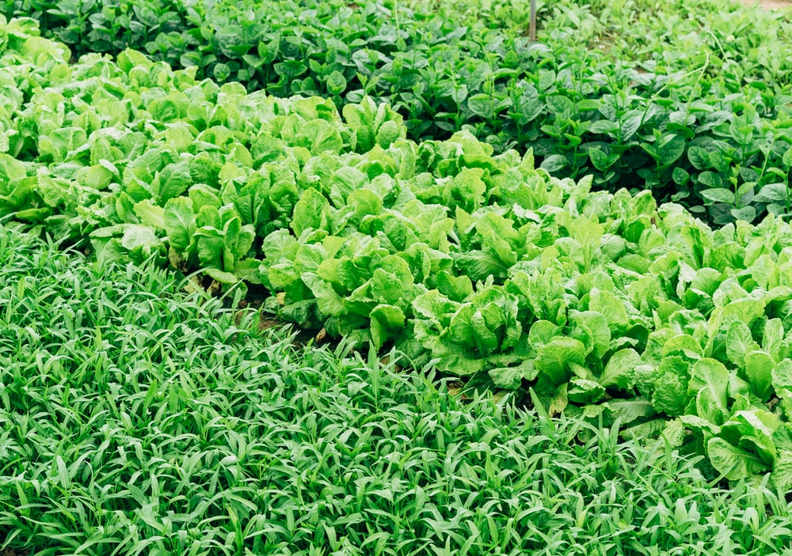
John Terborgh called this
“The Paradox of Luxuriance”

Slide 35
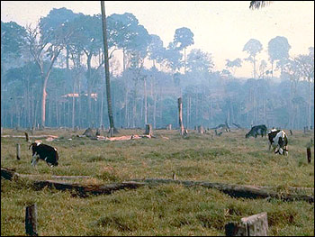
John Terborgh called this
“The Paradox of Luxuriance”

Slide 36
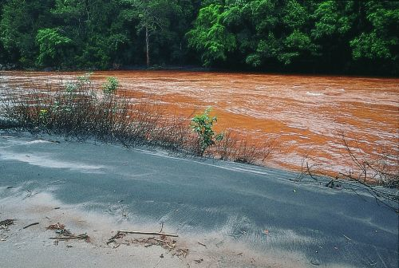
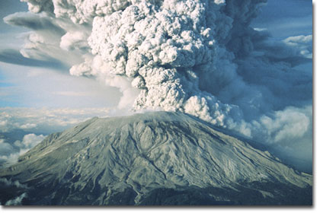
How do nutrients get back into the soils?
Rain
Exposure of new parent material
River deposits
Volcanoes
Outer space
Nutrient Cycling / Decomposition

Slide 37
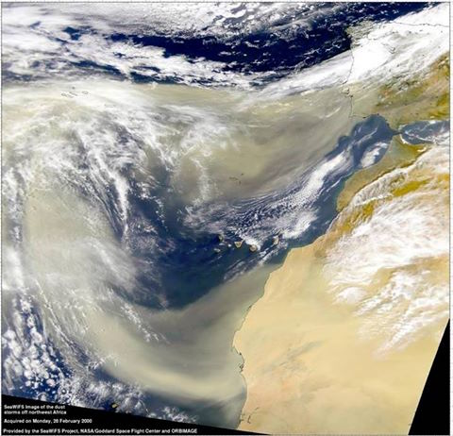

Slide 38
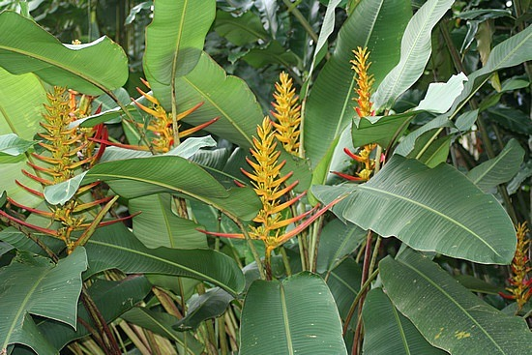
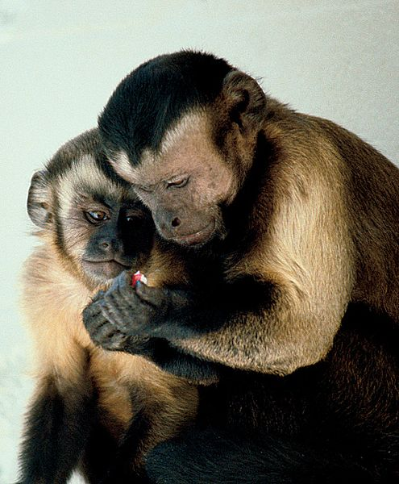
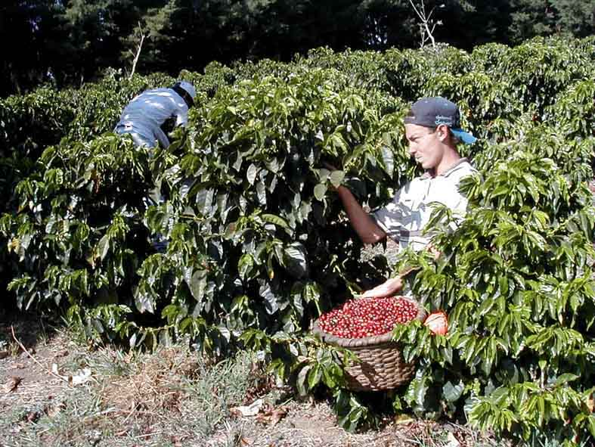
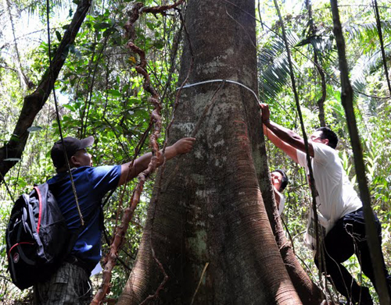
Variability in soil quality has major ecological impacts
Plant fertility
Animal abundance,
Home range sizes,
Human settlement and agriculture
Forest biomass

Slide 39
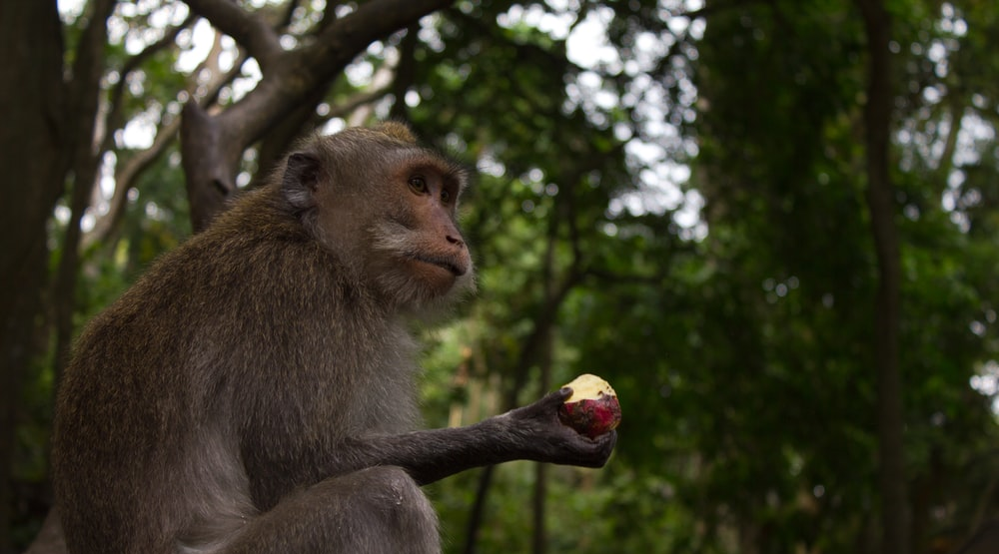


Slide 41

Wind Pollination
1-2% of plant species
Cecropiaceae (Moraceae), Cecropia obtusifolia
Why might this be a tough strategy in the tropics?
Notes:
High humidity and rainfall: reduce pollen in air
Low probability of landing on a conspecific (b/c of high diversity, low abundance)
Not much wind (especially in understory)

Slide 42



Most (tropical) plants are pollinated by animals!
Bats
Old World – Megachiroptera
Adansonia digitata (Bombacaceae)
New World - Microchiroptera
>500 species of plants in >27 families
Notes:
What might some of the costs and benefits of bat pollination be?

Slide 43



Non-flying mammals
kinkajou (Potos flavus)
Ravenala madagascariensis
Notes:
What might some of the costs and benefits of mammal pollination be?

Slide 44




Birds
Neotropics
Paleotropics
Nectariniidae (Sunbirds) 123 species, Africa, SE Asia, N Australia
Meliphagidae (Honeyeaters)
~180 species, Australia, New Zealand, se Pacific, Hawaii
Trochilidae - ~320 species, N & S America
Notes:
What might some of the costs and benefits of bird pollination be?

Slide 45



The vast majority: Insects
Moths: Sphingidae (sphinx moths), Noctuidiae (small moths)
Bees: most important (LTRF: ~50% of trees & lianas,
Notes:
What might some of the costs and benefits of insect pollination be?

Slide 46




The vast majority: Insects
Wasps (Figs)
Beetles (Especially important to aroids, cyclanths, and palms)
butterflies
Thrips, Flies, other stuff
Notes:
What might some of the costs and benefits…you get the idea.

Slide 47
Can often tell what visits a plant by flora characteristics: Pollination Syndromes
Animal
Day/Night
Color
Odor
Shape
Beetles
Flies
Bees
Hawkmoths
Butterflies
Bats
Birds
Both
Dull/Wht
Frt/Aminoid
Flat, bowl, rad. sym
Both
Brn/Grn
Fetid
Flat or deep
Both
Variable
Sweet
Mod. deep,rad sym.
Night
White
Sweet
Deep, often w/ Spur
Both
Var/pink
Sweet
Deep or w/ Spur
Night
Wht/grn
Musty
Fleshy, Brush or Tube
Day
Vivid/Red
None
Tube
These are generalizations – lots of exceptions!!!!

Slide 48



Parkia pendula,
Fabaceae
Parkia
panurensis

Slide 49


Bombacopsis patinoi
Bombacaceae

Slide 50



Slide 51






Lamarouxia hyssophifolia
(Hummingbird)
Amorphophallus johnsonii
beetle/fly pollinated aeroid
Magnolia grandiflora
(Beetle)

Slide 52

Why do animals bother?
Notes:
Pollination is a mutualism
Examples of Rewards
Shelter
Food for themselves
Food for their offspring
Things to attract females
A place for reproduction

Slide 53



Figs and Fig Wasps
~1000 species of Ficus (Moraceae), each with own wasp pollinator (e.g., Pleistodontes imperialis for Ficus rubiginosa in Australia).
fig “fruit” is a synconium: the inside is full of male and female flowers.
Male and female fig wasps: male has a greatly reduced body & two primary purposes: (1) Inseminating female
(2) Drilling exit tunnels through syconium wall.

Slide 54

Notes:
Very precisely timed interaction between pollinators and male and female flowers.
•Female wasps enter a fig with receptive female flowers, oviposits in sterile flowers and dies.
•Males hatch first, mate with unborn females. Then they chew exit tunnels out of the fig before dying. Male flowers are starting to mature and produce pollen.
•Newly hatched females leave through the tunnels, but pick up pollen in doing so. When they enter a new fig they deposit the pollen on receptive female flowers as they search for oviposition sites.

Slide 55



Slide 56


How do plants attract pollinators?
Colors

Slide 57


Aromas
Anthurium formosum: Euglossines attracted to spearmint scent
Notes:
Aroideae (Araceae)
2,500 described species, most pantropical.
huge variety of scents (nauseating -→ delicious)
Many have heat-producing structures: this helps diffuse the odors.
Often pollinated by flies or beetles.

Slide 58


Arum nigrum (dung odor)
http://www.youtube.com/watch?v=4P8YhP5_oig&feature=related

Slide 59

This Titan Arum can be 12 feet tall, and emits a strong smell of decay.
The stench attracts insects, perhaps carrion beetles, for long distances to lay their eggs. They enter and transfer or receive pollen.
Male and female flowers mature at separate times to avoid self pollination.

Slide 60


Deception (pseudocopulation)
Ophrys apifera
Bulbophyllum dayanum

